Slide 1



AI Master Class series – Day 5
Face Detection & Tracking

Slide 2
Day-3 Agenda.
01.
02.
03.
Face Detection
Haar Cascade FrontalFace
Face detection & Tracking
Face detection & its application
Overview about the algorithm
Face detection & Creating database for face recogniton

Slide 3

Face Detection.
Face detection is a computer technology being used in a variety of applications that identifies human faces in digital images.
With face detection, you can get the information you need to perform tasks like embellishing selfies and portraits, or generating avatars from a user's photo. Because ML Kit can perform face detection in real time, you can use it in applications like video chat or games that respond to the player's expressions

Slide 4
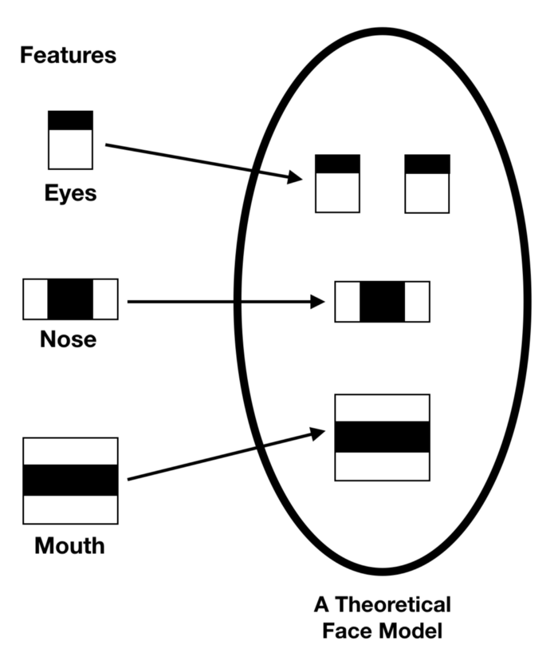
Haar Cascade FrontalFace Algorithm.
It is based on the Haar Wavelet technique to analyze pixels in the image into squares by function.
This uses machine learning techniques to get a high degree of accuracy from what is called “training data”.
This uses “integral image” concepts to compute the “features” detected.
Haar Cascades use the Adaboost learning algorithm which selects a small number of important features from a large set to give an efficient result of classifiers.

Slide 5
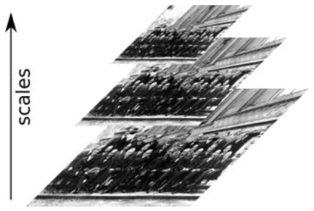
detectMultiScale.
#faces = face_cascade.detectMultiScale(src, scalefactor,minNeighbors)
faces = face_cascade.detectMultiScale(gray, 1.3, 4)
scaleFactor — Parameter specifying how much the image size is reduced at each image scale.
minNeighbors — Parameter specifying how many neighbors each candidate rectangle should have to retain it.

Slide 6
Block Diagram – Workflow of Face Detection.
Loading HaarCascadeFace Algorithm
Initializing Camera
Reading Frame from Camera
Converting Color image into Grayscale Image
Obtaining Face coordinates by passing algorithm
Drawing Rectangle on the Face Coordinates
Display the output Frame

Slide 7

Practical session

Slide 8
Face Detect.
import cv2
haar_file = 'haarcascade_frontalface_default.xml'
face_cascade = cv2.CascadeClassifier(haar_file)
webcam = cv2.VideoCapture(0)
while True:
(_, im) = webcam.read()
gray = cv2.cvtColor(im, cv2.COLOR_BGR2GRAY)
faces = face_cascade.detectMultiScale(gray, 1.3, 4)
for (x,y,w,h) in faces:
cv2.rectangle(im,(x,y),(x+w,y+h),(255,0,0),2)
cv2.imshow('FaceDetection', im)
key = cv2.waitKey(10)
if key == 27:
break
webcam.release()
cv2.destroyAllWindows()

Slide 9
Creating Face Dataset.
import cv2, os
haar_file = 'haarcascade_frontalface_default.xml'
datasets = 'dataset'
sub_data = 'champ'
path = os.path.join(datasets, sub_data)
if not os.path.isdir(path):
os.mkdir(path)
(width, height) = (130, 100)
face_cascade = cv2.CascadeClassifier(haar_file)
webcam = cv2.VideoCapture(0)
count = 1

Slide 10
while count < 31:
print(count)
(_, im) = webcam.read()
gray = cv2.cvtColor(im, cv2.COLOR_BGR2GRAY)
faces = face_cascade.detectMultiScale(gray, 1.3, 4)
for (x,y,w,h) in faces:
cv2.rectangle(im,(x,y),(x+w,y+h),(255,0,0),2)
face = gray[y:y + h, x:x + w]
face_resize = cv2.resize(face, (width, height))
cv2.imwrite('%s/%s.png' % (path,count), face_resize)
count += 1
cv2.imshow('OpenCV', im)
key = cv2.waitKey(10)
if key == 27:
break
print("Dataset obtained successfully")
webcam.release()
cv2.destroyAllWindows()

Slide 11
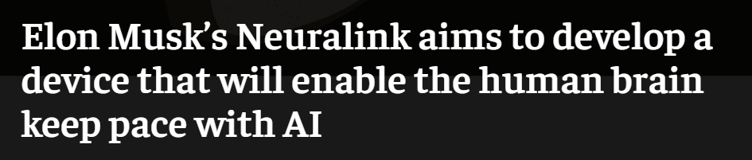
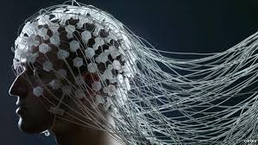
AI News – Day 5. 2016
“We can go to the hospital in the morning and leave by afternoon. And it can be done without general Anesthesia”
“We can save and replay memories. The future is going to be weird”

Slide 12

Thanks!
Tomorrow session
Do you have any questions?
sanjay@pantechmail.com
www.pantechsolutions.net
Object tracking based on color

Slide 13
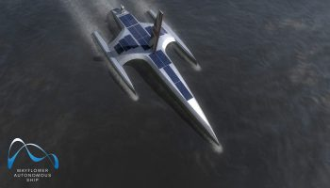
AI News – Day 4. SEP-2020
A(I)hoy, mateys: IBM’s crewless ocean research ship to launch ‘very soon’
IBM’s crewless AI-powered ship is due to begin roaming the oceans this month, collecting vital data about something we still know incredibly little about.

